Slide 1
PuRSSE
Pubmed Research Search String Extraction
Melanie Huston
James Lavinder
Richard Lusk
Franklin Sayre

Slide 2
Introduction to Systematic Literature Reviews
The first stage of creating a systematic review often involves taking a known set of articles and iteratively looking through metadata and keywords to create an extensive search string that can find both those target articles and other similar articles
The reviewers then manually narrow down the relevant articles through title and abstract manual reviews
This process is very time consuming and depending on the scale of the project can take weeks-to-months to complete
The possibility for time savings is introduced before the manual review process to try to help reduce the initial number of articles that a reviewer would have to review

Slide 3

Objectives and Goals
This project aims to create a pipeline for taking a set of known PMIDs and discovering the Shortest Precise Search Strategy (SPSS) for PubMed that (a) retrieves all the original PMIDs, and (b) retrieves other articles related to the original topic(s) extracted from the known PMIDs.
The objectives include:
Create clusters of articles based on topic modeling (TF-IDF, LDA, Word Embedding) from PubMed-compliant XML file
Based on a set of known articles, find other articles that are similar using topic modeling (via either direct similarity comparison OR by building a new search string from metadata associated with topic clusters)
Compare known set of relevant PMIDs against larger set of PMIDs to verify recall and precision

Slide 4
Data - PubMed Articles
PubMed articles are downloaded as a XML file from NLM FTP, specified around the topic of Gout
We tested our model on ~10,000 abstracts – the goal is to correctly identify a predetermined list of 350 articles from the 10,000 articles
This is to be achieved by only using data from an initial sample of 7 articles (our ‘training’ data set)
The full PubMed data set is downloadable, however it is about 200GBs. This will cause major computing restrictions as many of the techniques used cannot be performed with reasonable time and financial resources
Articles can also be downloaded:
Directly through PubMed (https://www.ncbi.nlm.nih.gov/pubmed/)
through their API, Entrez Database (https://www.ncbi.nlm.nih.gov/books/NBK25501/)
Using PubRunner (https://github.com/NCBI-Hackathons/PubRunner)

Slide 5
Automation of Search Strategies Based on MeSH Keywords
Get a limited, known set of PMIDs which are relevant for literature review
Retrieve text and metadata for known PMID set:
Perform Topic Modeling to develop search strategy
Map topic clusters to specific MeSH terms
Title
Abstract Text
MeSH Major Headings
MeSH Subheadings
Keywords
TF-IDF
Doc2Vec and LDA (Title and abstract)
Word2Vec (MeSH terms)
Output new search strategy for PubMed search string using derived MeSH terms
Machine Learning Models
Ensure that the original, known PMIDs are present in new PubMed search results
Continue to refine new search string to find the minimal number of new search results that contain 100% of the original, known PMIDs
Evaluate final search strategy results for relevance to literature review

Slide 6
Process
Obtain metadata on PMIDs
Perform Topic Modeling and Word Embedding's to help develop MeSH search strategies
Ensure that the Pre Obtained PMIDs are present in updated PubMed search strategy
Metadata was extracted from PubMed XML files using python's lmxl package
Traditional data validation is used to determine precision and recall of our model
The following data is extracted: PMID / Title / Abstract / MeSH terms
NLP Modeling is performed on the Title and Abstract and MeSH terms. Models include TF-IDF, Doc2Vec, Word2Vec, and Latent Dirichlet Allocation
Similar documents are retrieved using a similarity metric, cosine-similarity and nearest-neighbors approach (K-D Tree)
New MeSH Keywords are determined by traversing the hierarchical structure of MeSH IDs
The results from the nearest neighbors and MeSH string matching are combined to form new MeSH terms
Our model is expandable into a user friendly HTML interface to allow users to quickly determine new MeSH search terms

Slide 7
Results
Initial model is trained off 5 documents
Our training set is 0.05% of the testing documents
From those initial 5, 23% of relevant documents are identified

Slide 8
Future Growth and Next Steps
Future Growth:
Our pipeline has been designed with scalability in mind
The code developed is an accessible python script and will be accessible with a user interface
Research feasibility of running model on larger datasets
Next steps:
Connect the Pipeline - Link the User Interface to the python script
Run our model on larger datasets to improve performance
Test model on other datasets to determine universal application
Developing expertise with MeSH term hierarchy – apply knowledge to model’s search strings

Slide 9
Appendix

Slide 10
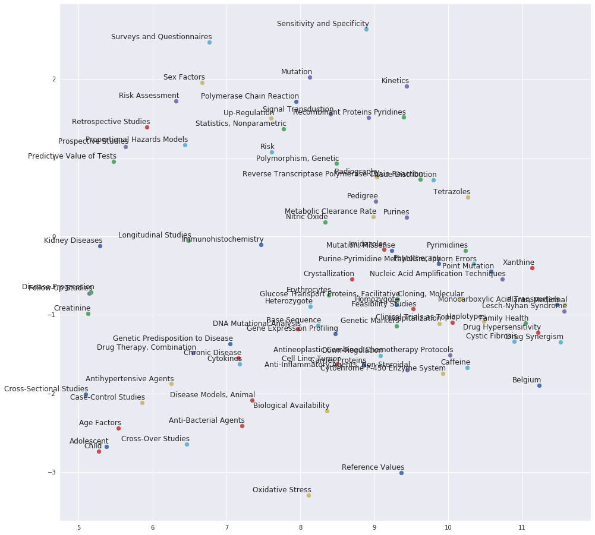
Results

Slide 11
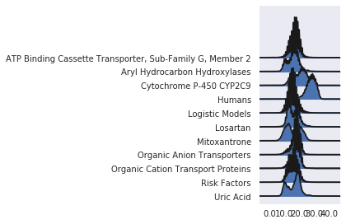
Joy Curve

Slide 12
Process
Perform Topic Modeling and Word Embedding's to help develop search strategies
Pre Obtained PMIDs which are relevant for literature review
Obtain metadata / on PMID data set
Output new search strategy of meta data search terms
Machine Learning Model
Ensure that the Pre Obtained PMIDs are present in updated PubMed search strategy

